Slide 1
Using [Go To Special] with [Ctrl + Enter]
Version: 05-Apr-2018

Slide 2
Data Cleaning
Folder M 02 > Filename “______________”

Slide 3
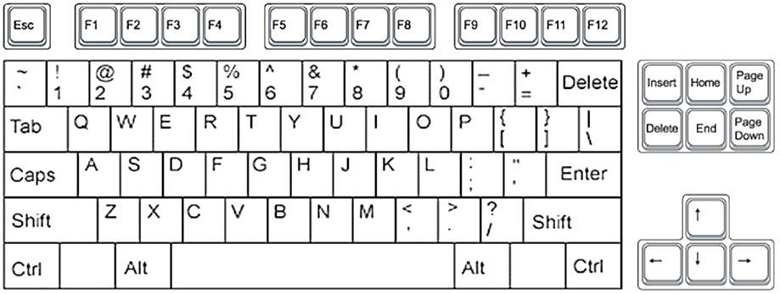
Ctrl + G (or F5) for Go To Special

Slide 4
Ctrl + Enter to fill selected cells
* Blanks

Slide 5
End

